Slide 1



First Review Car Racing Game
z

Slide 2
Group members
Dhruv Arora – 19MIM10014
Shrey Shrivastava – 19MIM10056
Asif Ali Sherani – 19MIM10104
Naman Arora - 19MIM10057

Slide 3
Literature Review
Car racing games in particular have evolved somewhat over the years. The first racing game dates back to the early 1970s, with arcade game producers Atari releasing Space Race. With the capacity for two players to play, gamers had to control their spaceship using a joystick and had to race against other ships while avoiding comets and meteors. As you might expect from a game released in 1973, Space Race was exclusively played in black and white.
The 1990s was a pivotal era for car racing games. Geoff Crammond, a leading figure in the advancement of video games during the mid-1980s, helped to develop Formula One Grand Prix in 1992, which was the new champion of simulation racing. Without a doubt, the game boasted the kind of detail that was unparalleled during the period – offering players a full recreation of drivers, cars and circuits in the 1991 Formula One World Championship.
By the mid-1990s, 3D technology was ripe in gaming and that was no different for racing car games. In fact, almost every game produced at the time gave users a 3D driving experience, which helped to make players feel as though they were physically racing the cars. In 1997, it was about to take another shift as PlayStation released the first ever Gran Turismo game. At the time, it was widely considered the best racing car game around.

Slide 4
Today, car racing video games have transformed from one-dimension, low quality gaming experiences to a 360-degree, high definition experience with a plethora of suitable options. It doesn’t matter whether you prefer Formula One, rally driving or even an animated game like Crash Team Racing, with remastered editions of older games readily available, the gamer is now in total control.
In recent years, game makers have taken a more sophisticated approach to NPCs. For example, some are now programmed with a behavior tree, which enables them to perform more complex decision-making. The enemy aliens in Halo 2, for example, have the ability to work together and coordinate their attacks, rather than heedlessly beeline into gunfire one by one like they’re in a cheesy action movie. In the future, we can expect to see more advanced AI appear in racing games.
For decades, virtual reality has tantalized gamers with the prospect of a fully immersive experience, and virtual reality in racing games could be the next big development in racing games.
Players gather in a physical space, like the inside of a warehouse, and strap on helmets and computers that double as backpacks. They proceed to participate in a virtual activity together, a mission. But unlike the typical VR experience, where everything takes place inside the goggles, hyperreality game players will notice that what they see in their headsets actually corresponds to the physical space of the room. So they can run around, duck and, in some cases, even reach for a virtual object and feel it — in the form of a strategically placed physical prop. The interplay between virtual reality and tactile feedback creates a uniquely immersive experience.

Slide 5
Module Description
For this Car Racing Game, we would like to accomplish a video game imitating the existing game with a projective view. The theme of our game is to compete with an opponent that is controlled by computer in a racing tournament, the player’s goal is to get to the destination as soon as possible while trying to avoid bumping into the other car or road object, the final score will be posted according to the finishing position, numbers of bumps and the time.
This game consists of three major modules. First part is the Game Logic Generator which calculate the logic of this game, such as to detect bumps to obstacle, speed control based on keyboard input, opponents control and road generation, and this module is based on software. The second part is the Screen Rendering Module, we adopt the Sprite Graphics technique to decompose the display screen into 7 layers, which will be explained in details in later section. The last part is the Audio Module which generate the proper sound under the control of game logic.

Slide 6
Game logic module(software)
The Game Logic Module generates all the motion control signals of all the objects in this game according to various algorithms and feed the signal to Sprite and Audio modules using Driver Function implemented.
To implement the action of moving forward, we first make the end of the road at the center of the screen to make sure the player’s focus is on the road. Then we create stripes of two different patterns, one is light and the other is dark. We keep switching positions of two kinds of stripes to generate the effect of moving the road. We use the up arrow on the keyboard to speed up. When the up arrow is pressed, we raise the switching frequency to make the road move faster. When the player’s car hit the back of another racing car, it slows down and we lower the switching frequency. When the player’s car passes another car, we simply move the car that gets passed from its current position down to the bottom of the screen and then disappear. By moving the car, we will also keep scaling the car. The similar algorithm applies when the player’s car gets passed; we just move the passing car from the bottom of the screen up and keep scaling the car as it moves.
We use the left and right key to control the left and right movement of player’s car. We will keep track of the position of the car. When left or right key is pressed, we move the position of the car to the left or right lane and draw the car based on the position.

Slide 7
Sprite Control Module (Hardware)
The Game Logic Module provides the X and Y coordinates for different objects, like trees, clouds, cars, scores, speed, which is also called Sprites. These Sprites are like label pictures store in ROM, and can be pasted to the screen according the X and Y coordinates.
The Sprite Controller Module merges the different Sprites to generate the final RGB information for displaying on the screen. The software generates the coordinate (X, Y) of different Sprites and passes coordinates to the Avalon Bus through the Kernel Driver. Then these data accompanied with address information in update the register file related to the specific Spite, the Sprite Controller fetches the RGB information from specific Sprite picture ROM, which finally merges all the pictures according to the priority and send to VGA module. The picture is finally showed on the screen. To make the Sprite move, the software just update the (X, Y) coordinate register file continuously.

Slide 8
Audio design
Audio Generator Module is designed to send instructions to the Audio Controller Module in order to play appropriate sound effect according to the game processes. For example, the background music is always A(X,Y) . .B C. on during the period when game is on. And special sound effects such as vehicle acceleration, braking, and collisions are integrated when the specific situations happen. At the beginning of the game, the software extracts the background sound sample previously stored in the SDRAM and load it into the circular queue in the Audio Controller Module, which will continuously send signals to the SSM2603 Audio Codec to play the background sound sample until the player exit the game. During the car racing, the software continuously checks whether the player hits the acceleration or braking button, or if there is any collision happens. Whenever a specific situation is detected, the software will instruct the DRAM to load the corresponding special sound effect into FIFO, and instruct the SSM2603 Audio Codec to play the special sound effect.

Slide 9
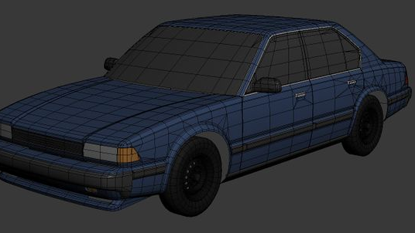
Module work flow explanation
This description of a general workflow focuses on the different steps of creating 3D game car and racing track using traditional tools and techniques commonly used in the game industry, and is described from the point of view of an asset production pipeline in a game studio where different steps are done. However, this is not the definitive workflow for creating 3D game characters, but just one example of how the process could be executed. For example, in a small independent game studio all of the following steps could be performed by a single artist, instead of several specialized artists dedicated to each different task. In addition to describing the different steps in the workflow of creating a 3D game character, some of the technical concepts related to the process will also be explained, as well as how artists need to take them into consideration in their work.

Slide 10
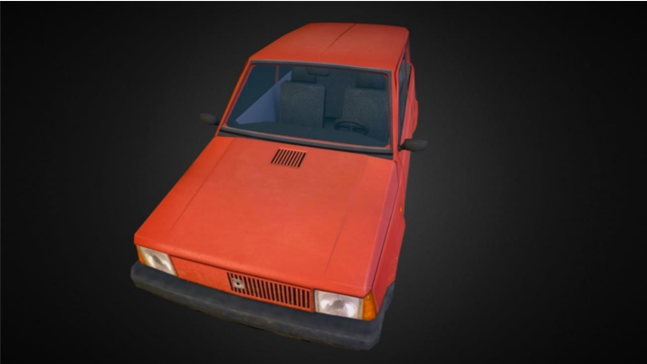
There are also tools and programs that attempt to automatically UV unwrap a 3D model, or pack the UV map effectively to maximize the use of texture space. Tools like these can be found in many popular 3D modeling programs, but there are also several programs and plugins dedicated specifically for these tasks, such as Roadkill, TexTools, iPackThat, UVLayout, and Unwrella. Using these tools can greatly reduce the time needed to UV map a 3D model, but they usually still require some input from the user, and the results often require some manual tweaking, especially for game assets which need to be optimized
z

Slide 11
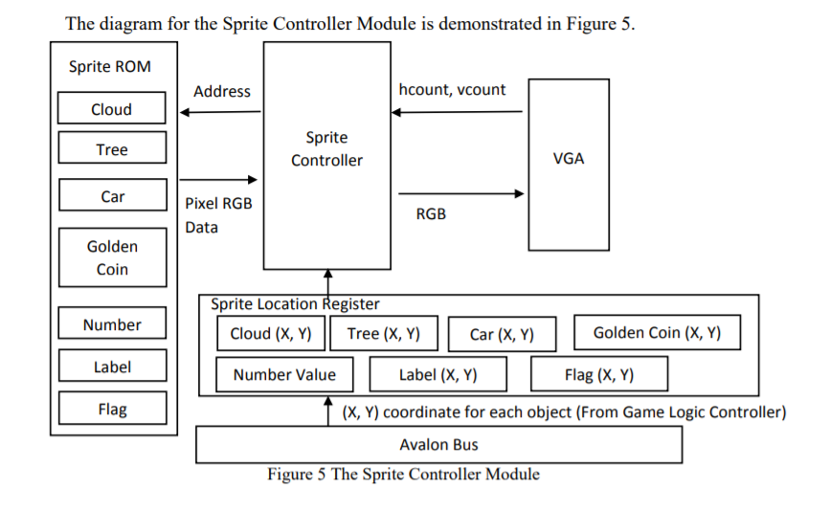

Slide 12
Implementation and coding
Car mesh:
Acar_racingPawn::Acar_racingPawn(){
static ConstructorHelpers::FObjectFinder<USkeletalMesh> CarMesh(TEXT("/Game/VehicleAdv/Vehicle/Vehicle_SkelMesh.Vehicle_SkelMesh"));
GetMesh()->SetSkeletalMesh(CarMesh.Object);
static ConstructorHelpers::FClassFinder<UObject> AnimBPClass(TEXT("/Game/VehicleAdv/Vehicle/VehicleAnimationBlueprint"));
GetMesh()->SetAnimationMode(EAnimationMode::AnimationBlueprint);
GetMesh()->SetAnimInstanceClass(AnimBPClass.Class);
// Setup friction materials
static ConstructorHelpers::FObjectFinder<UPhysicalMaterial> SlipperyMat(TEXT("/Game/VehicleAdv/PhysicsMaterials/Slippery.Slippery"));
SlipperyMaterial = SlipperyMat.Object;
static ConstructorHelpers::FObjectFinder<UPhysicalMaterial> NonSlipperyMat(TEXT("/Game/VehicleAdv/PhysicsMaterials/NonSlippery.NonSlippery"));
NonSlipperyMaterial = NonSlipperyMat.Object;
UWheeledVehicleMovementComponent4W* Vehicle4W = CastChecked<UWheeledVehicleMovementComponent4W>(GetVehicleMovement());
check(Vehicle4W->WheelSetups.Num() == 4);

Slide 13
Wheels
Vehicle4W->WheelSetups[0].WheelClass = Ucar_racingWheelFront::StaticClass();
Vehicle4W->WheelSetups[0].BoneName = FName("PhysWheel_FL");
Vehicle4W->WheelSetups[0].AdditionalOffset = FVector(0.f, -8.f, 0.f);
Vehicle4W->WheelSetups[1].WheelClass = Ucar_racingWheelFront::StaticClass();
Vehicle4W->WheelSetups[1].BoneName = FName("PhysWheel_FR");
Vehicle4W->WheelSetups[1].AdditionalOffset = FVector(0.f, 8.f, 0.f);
Vehicle4W->WheelSetups[2].WheelClass = Ucar_racingWheelRear::StaticClass();
Vehicle4W->WheelSetups[2].BoneName = FName("PhysWheel_BL");
Vehicle4W->WheelSetups[2].AdditionalOffset = FVector(0.f, -8.f, 0.f);
Vehicle4W->WheelSetups[3].WheelClass = Ucar_racingWheelRear::StaticClass();
Vehicle4W->WheelSetups[3].BoneName = FName("PhysWheel_BR");
Vehicle4W->WheelSetups[3].AdditionalOffset = FVector(0.f, 8.f, 0.f);
// Adjust the tire loading
Vehicle4W->MinNormalizedTireLoad = 0.0f;
Vehicle4W->MinNormalizedTireLoadFiltered = 0.2f;
Vehicle4W->MaxNormalizedTireLoad = 2.0f;
Vehicle4W->MaxNormalizedTireLoadFiltered = 2.0f;

Slide 14
Engine
Vehicle4W->MaxEngineRPM = 5700.0f;
Vehicle4W->EngineSetup.TorqueCurve.GetRichCurve()->Reset();
Vehicle4W->EngineSetup.TorqueCurve.GetRichCurve()->AddKey(0.0f, 400.0f);
Vehicle4W->EngineSetup.TorqueCurve.GetRichCurve()->AddKey(1890.0f, 500.0f);
Vehicle4W->EngineSetup.TorqueCurve.GetRichCurve()->AddKey(5730.0f, 400.0f);
// Adjust the steering
Vehicle4W->SteeringCurve.GetRichCurve()->Reset();
Vehicle4W->SteeringCurve.GetRichCurve()->AddKey(0.0f, 1.0f);
Vehicle4W->SteeringCurve.GetRichCurve()->AddKey(40.0f, 0.7f);
Vehicle4W->SteeringCurve.GetRichCurve()->AddKey(120.0f, 0.6f);
// Gears
// For Four Wheel drive
Vehicle4W->DifferentialSetup.DifferentialType = EVehicleDifferential4W::LimitedSlip_4W;
// Drive the front wheels a little more than the rear
Vehicle4W->DifferentialSetup.FrontRearSplit = 0.65;
// Automatic gear changing
Vehicle4W->TransmissionSetup.bUseGearAutoBox = true;
Vehicle4W->TransmissionSetup.GearSwitchTime = 0.15f;
Vehicle4W->TransmissionSetup.GearAutoBoxLatency = 1.0f;

Slide 15
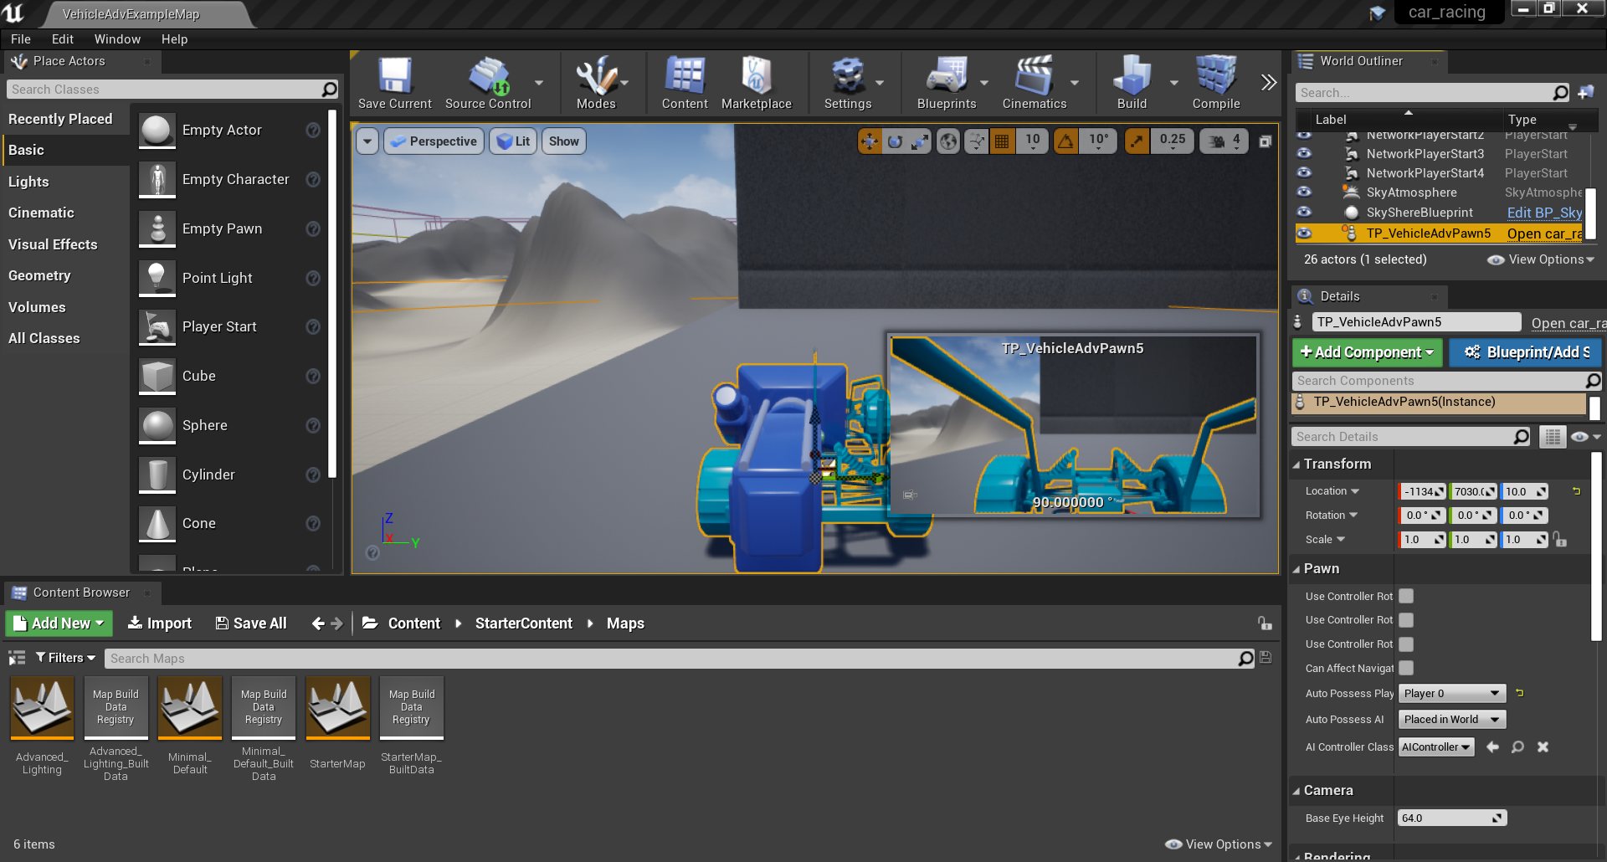

Slide 16
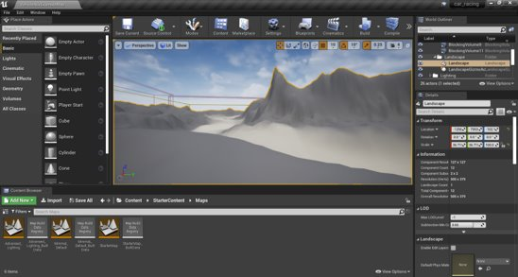

Slide 17
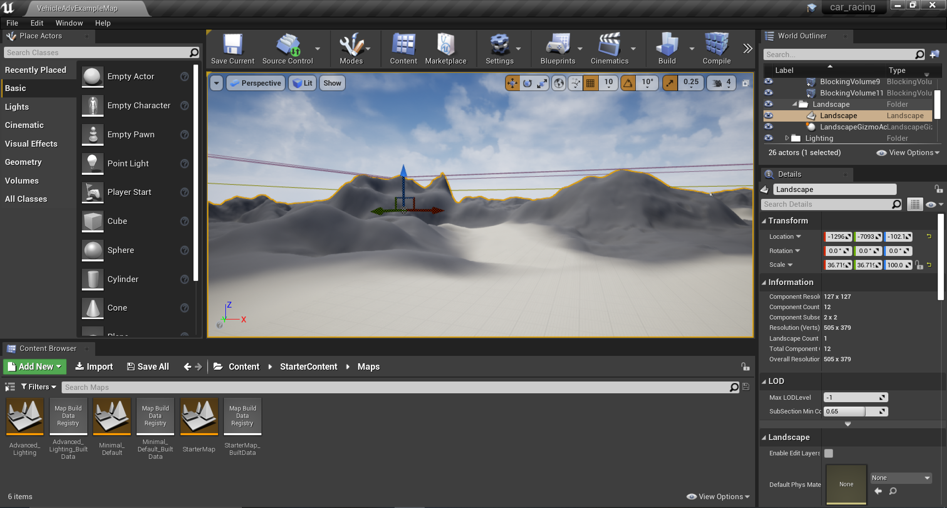

Slide 18

Demo video

